Slide 1

Shithi's Customer Stint - Learnings
Presented by: Shithi Maitra, Asst. Manager, CSE
Presented on: 03-Jan-24, Tenure: 20-Nov-23 to 10-Jan-24
Special Thanks to: Anika Hasan, Executive, CSE

Slide 2
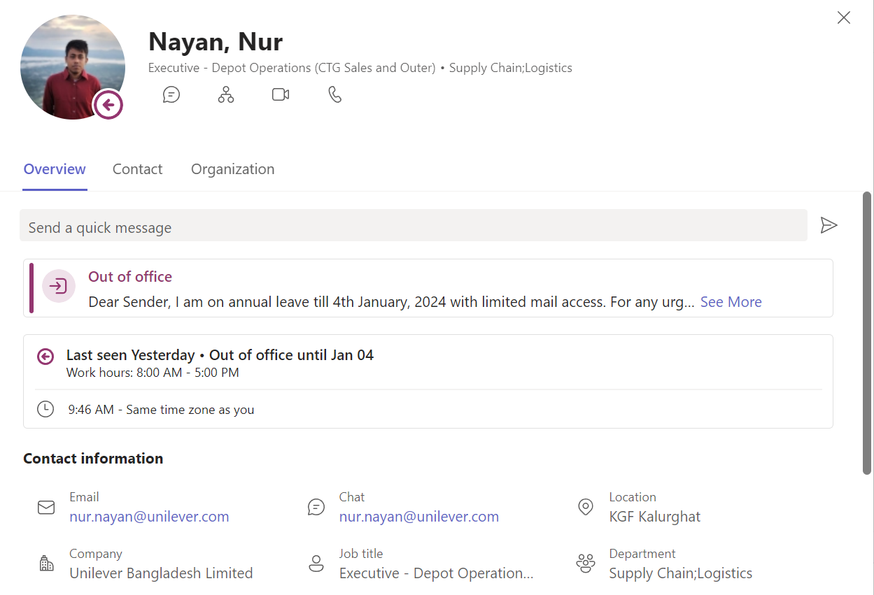


Concerned Personnel - Depot Incharge (DIc)
Role Played
- Manages invoice operators
- Facilitates DD requests

Slide 3
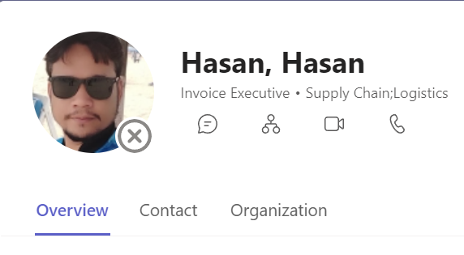
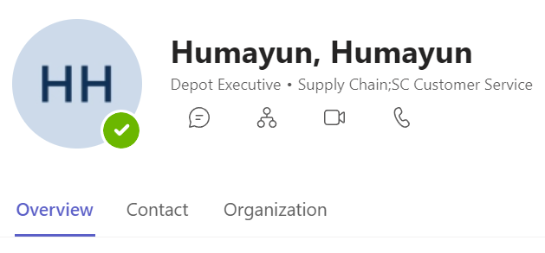
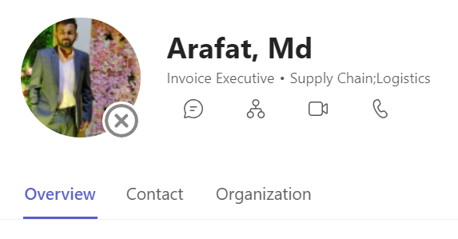

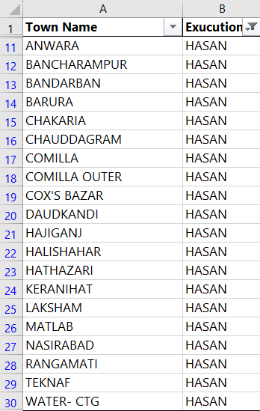
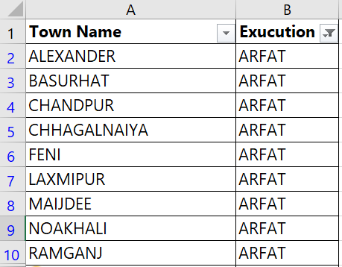
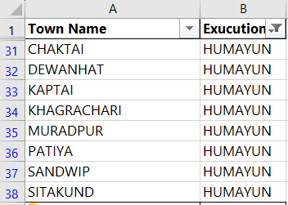
Concerned Personnel - Invoice Operators
Role Played
- Responsible for invoicing to designated towns
- Comes in contact with TM after CSE approval (eg, load fill)

Slide 4



Concerned Personnel – Area Managers, Territory Manager
Role Played: AMs
- Manages TMs
- Reaches out to CSE on crtical issues, eg, allocation >> plan
- Is kept in communication loop in case discipline is compromised
- Typically has multiple TMs reports
Role Played: TMs
Area - 01
Feni
Muztaba Ali, AM
Area - 02
Comilla
Imrul Kabir, AM
Area - 03
Chittagong
Akhtar Hossen, AM
- Responsible for lifting as per PDP and plan from CDOps
- May be assigned to > 1 towns
- Reports to one AM
* Although in CTG, Nabinagar and Companyganj are served from Dhaka, and Hatiya from Barisal

Slide 5









Important Files and Reports
PDP Master
Plan - UBL + UCL Seperate, by Arafath bh., CDOps
Allocation Report - UBL, UCL Seperately by Kader bh., CSE
Replenishment Report, by Kader Bh.
Daily Stock, from Minimax
All Town Confirm Orders, for SNC Saved value and Utilization of Locks
Fund Loss Report, from Allobot (allobot.ubl@unilever.com)
Unutilized Funds, UBL-UCL Seperately from Kader bh.
DR Loss Report, from Allobot (allobot.ubl@unilever.com)

Slide 6



Customer Issues
Issue-01: Additonal Manual Orders
Issue-02: No Allocation Report
Issue-03: Add/Drop Request
Step-1: If 10-20 CS, allowable
Step-2: If more, depot stock should be checked
Step-3: If depot stock plenty, allowable, otherwise drop line
Step-4: Communicate approved manuals to Kader bh. keeping TM in cc
Checkpoint-1: Is today a PDP day?
Checkpoint-2: If not, was non-PDP approval taken?
Checkpoint-3: Was fund available?
Case-1: If fund recently made available, a manual lifting may be allowed.
Check DOH from RPL
Drop:
If DOH > 25, drop may be catered if depot workload supports.
Add:
Dropped value can be served if desired SKU is not stock-critical.

Slide 7



Customer Issues (Continued)
Issue-04: Allocation > Plan/SNC Saved
Issue-05: SNC Locked
Issue-06: SNC Extension
- Check SNC Saved Value from All Town Confirm Orders file
- Confirmed Value must be lifted, the remaining is subject to business criticality
- Cofirmed Value will resemble PPO Value if SNC not saved, action must align AM
- Was high SNC issue reported?
- IT Shawon bh. to be reached out for help
- If unsolved, SNC export will be shared
- The reply will be treated as SNC order qty, with a SNC-default mark for OPD
- SNC Cutoff may be extended till 04:30 PM provided proper reasoning is offered

Slide 8




Customer Issues (Continued)
Issue-07: Non PDP Lifting
Issue-08: Exceptional Cases of Lifting
Issue-09: Multiple Invoice Files
Solution: Come in contact with DMS Support, after CSE approval
Step-01: Clear plan communication to CSE from TM
Step-02: Clear communication to Depot from CSE mentioning town, depot, plan, reason
Step-03: Communication of updated prices against invoiceable materials
Issue-10: Delayed Fund
- Approval required from Logistics
- If approval not taken earlier, manual lifting may be allowed under exceptional circumstances
Step-01: Inform CSE previous evening Step-02: Instruct depot to halt, check fund Step-03: Approve manual
Thanks!

Slide 9



Customer Issues & Improvements
Issue-11: Price not Updated
Scopes for Improvement
Context: Distributor margin renewal Step-01: Ask planner for updated price list
Step-02: Create new material code against updated prices Step-03: Share with depot and instruct to invoice against updated materials
Technical:
- Semi automations can be made for depot stock checking Disciplinary:
- TMs should be more handy with allocation reports, PDPs, SNC
- TMs may consider ensuring a smoother cash flow
Further Queries?
Shithi Maitra
Asst. Manager, CSE
Unilever BD Ltd.
shithi.maitra@unilever.com

Slide 10





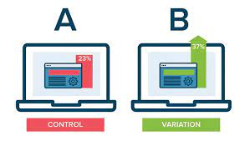
2024 SC CoE: Greater Capabilities, Monitoring & Scaling
Greater Image Processing Capabilities
Greater Capability in Ad Analytics
Greater Capability with Textual Data
Scope-01: Monitor competition campaigns across popular national websites
Scope-01: Analyze advertisement trends across newspapers, social media, apps
Scope-01: Warehouse
all consumer’s remarks
Scope-02: Classify and redirect to respective stakeholders
Better Scaled Analytics
Better Utilization of Free APIs
Launch More Experiments
Scope-01: Set up a database system Scope-02: Purchase a Cloud Solution (preferably Google Cloud)
Scope-01: Google Analytics Scope-02: Facebook API Scope-03: OCR API Scope-04: text-to-speech
Scope-01: A-B tests Scope-02: Random Control Experiments (eg, QMix)

Slide 11

Daily News for Action DNA

